Slide 1


Welcome!
Workshop
3 of 7

Slide 2
Today's Topics
Review of Workshop 2
Diagram Disable Structure
Conditional Structure
Event Structure

Slide 3
Review Question 1
If I add a new element to an enum that is saved in a *.ctl file, how would the file need to be saved in order to update all of instances
Custom control
Strict Type Definition
Type Definition

Slide 4
Review Question 1
If I add a new element to an enum that is saved in a *.ctl file, how would the file need to be saved in order to update all of instances
Custom control
Strict Type Definition
Type Definition
Notes:
Type definitions and strict type definitions have links to the *.ctl file. A change to the enum elements is considered a change to the data type, so both the type def and the strict type def will update their instances.
Custom controls do not have links to the *.ctl files, so the changes would not show in the instances.
Another common use for type definitions is clusters because the elements within a cluster define the type of cluster it is (data type)

Slide 5
Review Question 2
Which of the following always remain unique to each instance?
Label
Default value
Size
Data type
Representation (numerics)
Description

Slide 6
Review Question 2
Which of the following always remain unique to each instance?
Label
Default value
Size
Data type
Representation (numerics)
Description
Notes:
Strict type definitions cause everything to be the same for each instance, except the label, default value, and description.

Slide 7
Review Question 3
True or False?
A custom control can only be used for the project within which it was created.

Slide 8
Review Question 3
True or False?
A custom control can only be used for the project within which it was created.
FALSE
Notes:
Custom controls and type definitions are available across VIs, projects, computers, etc. The file stores the customizations for the purpose of easy reuse.
Note: it is a good idea to store a type definition locally, so the file linkage is not broken. For example, if the *.ctl file were stored on a portable storage device like a flash drive and it was removed, LabVIEW would not be able to access the file to make changes to it and should throw a warning.

Slide 9

Diagram Disable Structure
Use to disable a section of code on the block diagram
Multiple subdiagrams possible – maximum of one enabled
Disabled subdiagrams appear grayed out
Great tool for troubleshooting – don’t have to re-write code
Notes:
Disable structure contains multiple subdiagrams of which exactly one compiles and executes. Code within the inactive subdiagrams does not compile or execute at run time. You can use disable structures to make sections of code on the block diagram inactive.
When LabVIEW loads a VI with user-defined objects, such as subVIs and typedefs, in the Disabled subdiagram of a a Diagram Disable structure or in the inactive subdiagrams of a Conditional Disable structure, LabVIEW does not load these objects into memory. However, when you display the block diagram of the VI, LabVIEW attempts to load those objects. If LabVIEW cannot find the objects, LabVIEW returns a warning, but the VI does not break because LabVIEW does not include the code when compiling and executing the VI.
Note LabVIEW does check the syntax of code in inactive subdiagrams. However, broken code within the inactive subdiagrams does not prevent the VI from compiling and executing.
Use the Diagram Disable structure to disable specific code on the block diagram. Use the Conditional Disable structure to define conditions that indicate which code on the block diagram executes.
Conditional Disable Structure
The Conditional Disable structure, shown as follows, has one or more subdiagrams, or cases, exactly one of which LabVIEW uses for the duration of execution, depending on the configuration of the conditions of the subdiagram. When compiling, LabVIEW does not include any code in the inactive subdiagrams of the Conditional Disable structure.
Use the Conditional Disable structure to define conditions in which specific code compiles and executes. For example, if one section of the VI is target-specific, you can put this code in a Conditional Disable structure and configure it to run on the specific target. Targets you might configure a Conditional Disable structure for include Windows, Mac, Unix systems and FPGA targets.

Slide 10
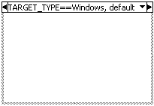
Conditional Disable Structure
Use to define conditions that indicate which code on the block diagram executes
Examples:
If running as an executable, then programmatically close LabVIEW when VI finishes
If running on Windows, look for file here; if running on Mac OSX then look here.
Notes:
Use the Conditional Disable structure to define conditions that indicate which code on the block diagram executes.
Conditional Disable Structure
The Conditional Disable structure, shown as follows, has one or more subdiagrams, or cases, exactly one of which LabVIEW uses for the duration of execution, depending on the configuration of the conditions of the subdiagram. When compiling, LabVIEW does not include any code in the inactive subdiagrams of the Conditional Disable structure.
Note LabVIEW does check the syntax of code in inactive subdiagrams. However, broken code within the inactive subdiagrams does not prevent the VI from compiling and executing.
Use the Conditional Disable structure to define conditions in which specific code compiles and executes. For example, if one section of the VI is target-specific, you can put this code in a Conditional Disable structure and configure it to run on the specific target. Targets you might configure a Conditional Disable structure for include Windows, Mac, Unix systems and FPGA targets.

Slide 11
Events
Event — An asynchronous notification that something has occurred
Events originate from the user interface, external I/O, or other parts of the program
Example events:
Button click
Value change
Mouse over
Key press
Notes:
When something happens (a button press, your mouse hovering over a particular region, pressing a key on the keyboard, clicking the mouse – examples of default events) an “event” is fired. This event can be “caught” and “handled” by an Event Structure. Therefore, when an event occurs (such as a mouse down on the Numeric as shown in the event selector label in this slide), the code inside the structure will execute (this slide’s example does not have any code to execute yet)
What Are Events?
An event is an asynchronous notification that something has occurred. Asynchronous describes a function that begins an operation and returns prior to the completion or termination of the operation.
Events can originate from the user interface, external I/O, or other parts of the program. User interface events include mouse clicks, key presses, and so on. External I/O events include hardware timers or triggers that signal when data acquisition completes or when an error condition occurs. Other types of events can be generated programmatically and used to communicate with different parts of the program. LabVIEW supports user interface and programmatically generated events but does not directly support external I/O events.

Slide 12
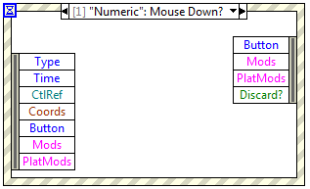
Event Structure
Event Structure — LabVIEW’s programmatic tool for handling events.
Therefore, execution of code can be dependent on whether or not an event has occurred
Waits for an event to occur indefinitely, unless configured to timeout.
Notes:
When something happens (a button press, your mouse hovering over a particular region, pressing a key on the keyboard, clicking the mouse – examples of default events) an “event” is fired. This event can be “caught” and “handled” by an Event Structure. Therefore, when an event occurs (such as a mouse down on the Numeric as shown in the event selector label in this slide), the code inside the structure will execute (this slide’s example does not have any code to execute yet)

Slide 13
Parts of an Event Structure
Event Data Node Identifies the data LabVIEW provides when the event occurs; similar to the Unbundle By Name function
Event Filter Node Identifies the subset of data available in the Event Data node that the event case can modify
Timeout
Event Selector Label
Event Data Node
Event Filter Node
Notes:
Parts of an Event Structure:
Event Selector Label — The event selector label at the top of the Event structure indicates which events cause the currently displayed case to execute. View other event cases by clicking the down arrow next to the case name and selecting another case from the shortcut menu.
Timeout — The Timeout terminal at the top left corner of the Event structure specifies the number of milliseconds to wait for an event before timing out. The default is –1, which specifies to wait indefinitely for an event to occur. If you wire a value to the Timeout terminal, you must provide a Timeout case.
Event Data Node — The Event Data node behaves similarly to the Unbundle By Name function. This node is attached to the inside left border of each event case. The node identifies the data LabVIEW provides when an event occurs. You can resize this node vertically to add more data items, and you can set each data item in the node to access any event data element. The node provides different data elements in each case of the Event structure, depending on which event(s) you configure that case to handle. If you configure a single case to handle multiple events, the Event Data node provides only the event data elements that are common to all the events configured for that case.
Event Filter Node — The Event Filter node is similar to the Event Data node. This node is attached to the inside right border of filter event cases. The node identifies the subset of data available in the Event Data node that the event case can modify. The node displays different data depending on which event(s) you configure that case to handle. By default, those items are in place to the corresponding data items in the Event Data node. If you do not wire a value to a data item of an Event Filter node, that data item remains unchanged. Refer to the Notify and Filter Events section of this lesson for more information about filter events.

Slide 14
Notify and Filter Events
Notify Events
User action has already occurred
LabVIEW has processed the event
Available only in the Event Data node
Filter Events
User action has already occurred
LabVIEW has NOT processed the event
Allows you to override default behavior for event
Available in the Event Filter node and Event Data node
Notes:
Notify and Filter Events
Notify events are an indication that a user action has already occurred, such as when the user has changed the value of a control. Use notify events to respond to an event after it has occurred and LabVIEW has processed it.
Filter events inform you that the user has performed an action before LabVIEW processes it, which allows you to customize how the program responds to interactions with the user interface. Use filter events to participate in the handling of the event, possibly overriding the default behavior for the event. In an Event structure case for a filter event, you can validate or change the event data before LabVIEW finishes processing it, or you can discard the event entirely to prevent the change from affecting the VI. For example, you can configure an Event structure to discard the Panel Close? event, preventing the user from interactively closing the front panel of the VI. Alternatively, you can discard the default Panel Close event and instead perform necessary cleanup or shutdown operations before closing the panel.

Slide 15
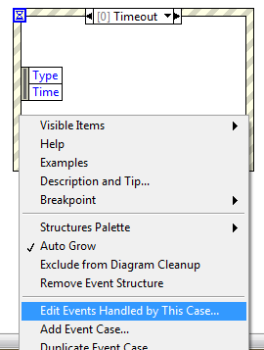
To Configure an Event Structure…
Right-click the border and select Edit Events Handled by This Case

Slide 16
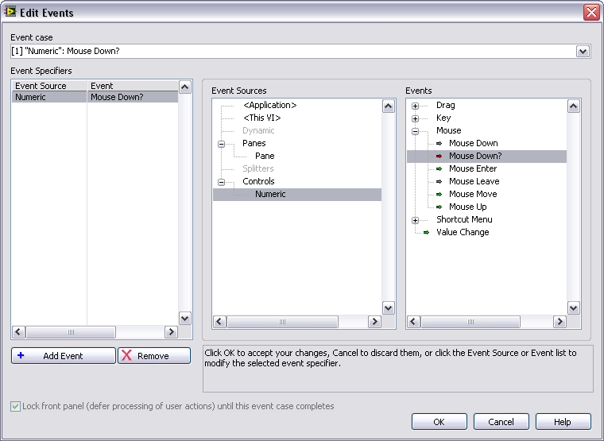
Configuring Event Structures
Configured Events
Event Sources
Events
Notes:
The dialog box is divided into 3 panes.
Configured Events: The left-most pane shows the list of specific events the current event case (sub-diagram) is configured to handle, displayed as pairs of <event source, event type>.
Event Sources: The middle pane shows the event sources (classes) you can choose from, which include the Application, the current VI, all of the controls on the VI’s front panel, and dynamic events.
Events: The right-most pane shows the individual events that the currently selected source on the left can generate. Clicking on an item in the event source or event type lists immediately updates the highlighted entry under Event Specifiers .
Notice that mouse and key events can be generated by either the VI or a control. You can set up the event structure to listen for both. LabVIEW delivers the VI event first, generated for mouse or key activity anywhere on the VI’s panel, and then the control event if the mouse was in a particular control, or the control had keyboard focus.
You can configure a single diagram to handle more than one event. To do this, click the Add Event button to add a new entry in Event Specifiers, and then use the Event Sources and Event panes to select its source and type. To share an event case, events should have compatible event data. Only data which is common to all events handled by an event case will be available in its event data node on the left border of the structure.
An event with a green arrow is a notify event; an event with a red arrow is a filter event.

Slide 17
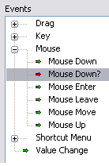
Notify and Filter Events in Config. Window
Notify Events (green arrow)
User action has already occurred
Filter Events (red arrow)
User performed action but event is not processed. Allows you to customize event handling.
Notes:
Notify and Filter Events
Filter events have names that end with a question mark, such as Panel Close?, to help you distinguish them from notify events. Most filter events have an associated notify event of the same name, but without the question mark, which LabVIEW generates after the filter event if no event case discarded the event.

Slide 18
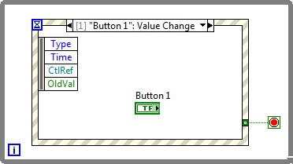
Using Event Structures
Normally used in a While Loop
Control/Indicator the event configured for is often placed inside that event case
Event structure handles exactly one event per iteration
Sleeps when no events occur
Notes:
Events are often used inside a while loop because they often are looking for multiple events throughout the duration of the program.
The control/indicator is often placed inside it’s event case because it is a tidy way to keep track of controls/indicators that you may not be directly reading the values from.
An even structure can only handle one event per iteration, which supports the use of an event structure in a loop when multiple events are configured.
While the event structure is not processing an event, it goes into a sleep mode – which lightens the load on the processor. This is a key benefit of the using the event structure over polling controls on the front panel with every loop iteration.

Slide 19
Event Structures Tips
If no timeout is configured and an event never occurs – stuck waiting indefinitely, must abort VI; therefore, wire the timeout terminal with a value other than -1 (at least while developing)
“heavy” code within the Event Structure causes the front panel to lock up, often confusing the user – try to keep code in an event case to a minimum
Notes:
By default, the front panel is locked while the Event Structure is handling the event. If it takes a long time for the Event Structure to handle an event due to intensive processing in the event case, the front panel will appear frozen to the user and could cause confusion.

Slide 20
Demonstration:
Configuring an Event
Notes:
Introduction to LabVIEW Hands-On 24 ni.com

Slide 21
Homework
Create a VI that uses events
Notes:
Introduction to LabVIEW Hands-On 24 ni.com

